Slide 1
Online House rental web portal
Advanced Object Oriented Programing
Under The Guidance
DR. Figlu Mohanty

Slide 2
Group 5 Team Members
UID | Name
2110030252 | Shaik Mohammed Afeef Sayeed
2110030190 | Karam Sai Vardhan Reddy
2110030109 | Dommata Harshavardhan Reddy

Slide 3
Introduction
To develop a house rental management system that allows the user to view customers' data as well as houses record
To study currently available online house rental system in the market in our country

Slide 4
About
Now a days city life is dependent largely on technology. Real estate or property sector is also using latest technologies.
So it is a highly potential sector in Bangladesh specially in urban areas. Also as a student ourselves, we have to stay far away from our home for study purpose and we need houses on rent for accommodation.
We had the first hand experience of how difficult it is to find a proper place for accommodation.

Slide 5
FUNCTIONAL REQUIREMENTS
Allow administrator to add a houses, tenant and defaulters details
Allow the administrator to delete houses, tenants and defaulters details
Allow the administrator to search data in the database
Allow the administrator to edit data in the database

Slide 6
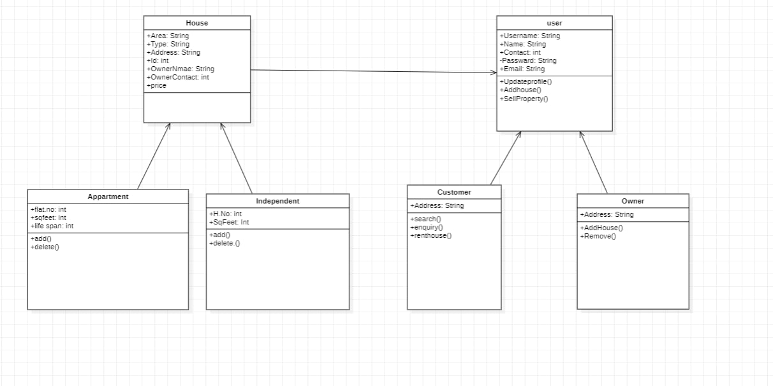
Class Diagram

Slide 7
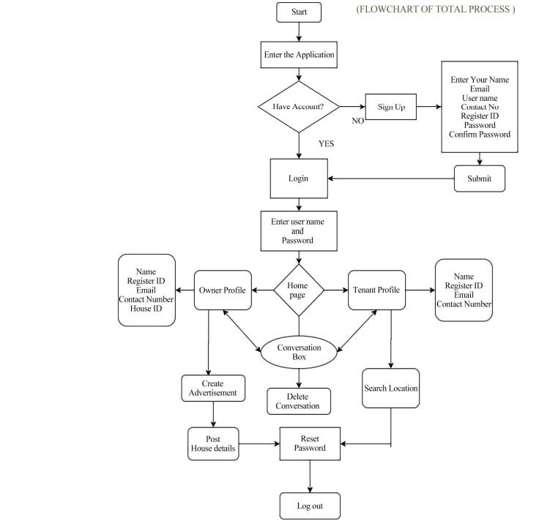
Activity Diagram

Slide 8
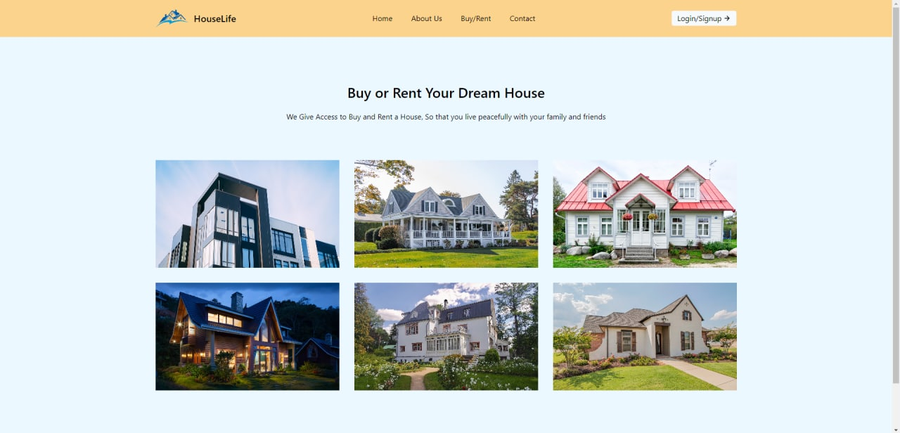
Prototype PICS
Home Page

Slide 9
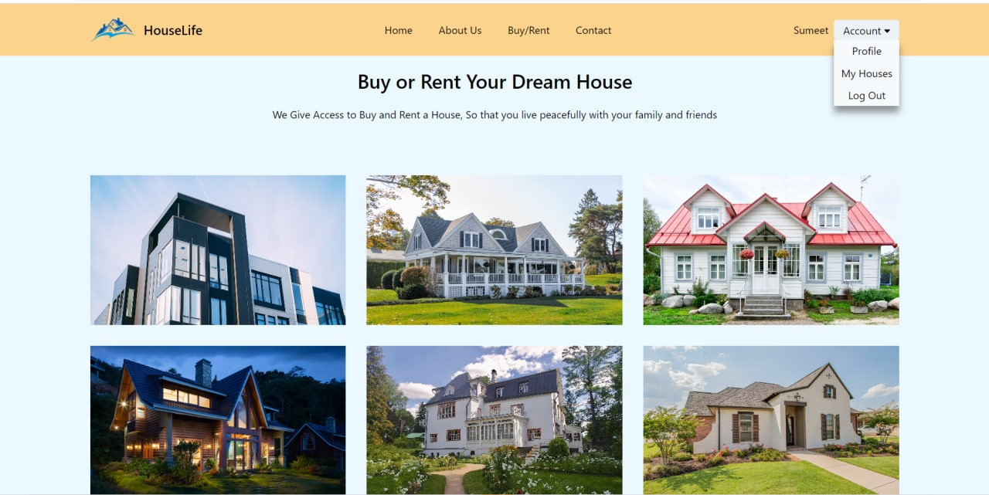
After Logging In:

Slide 10
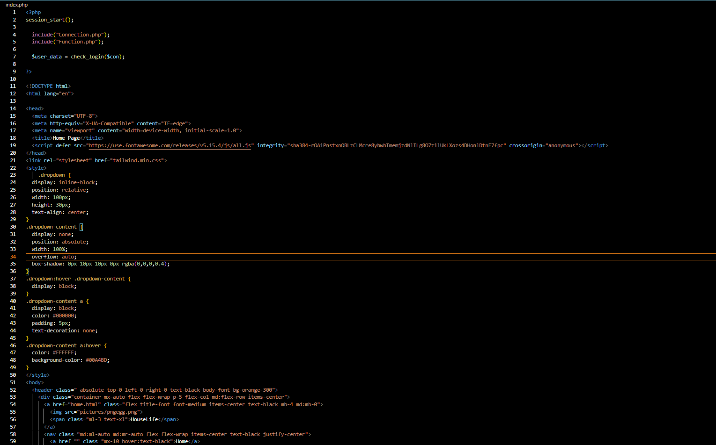
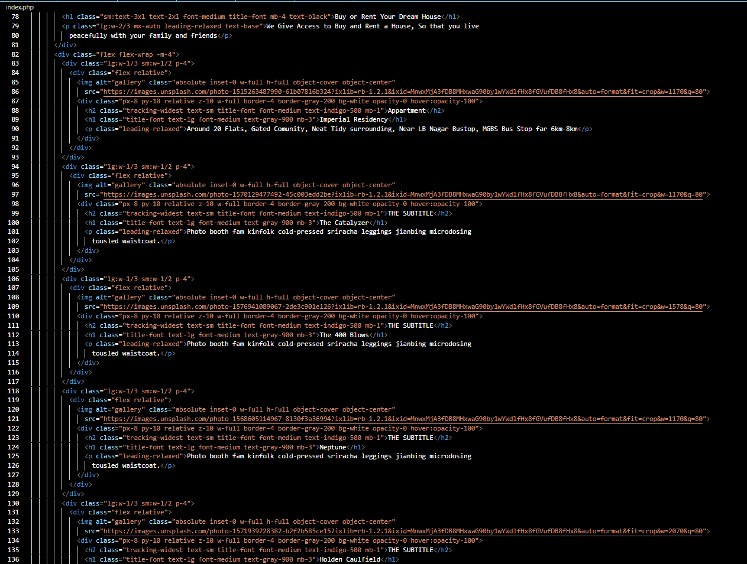
Home/Index page Code

Slide 11
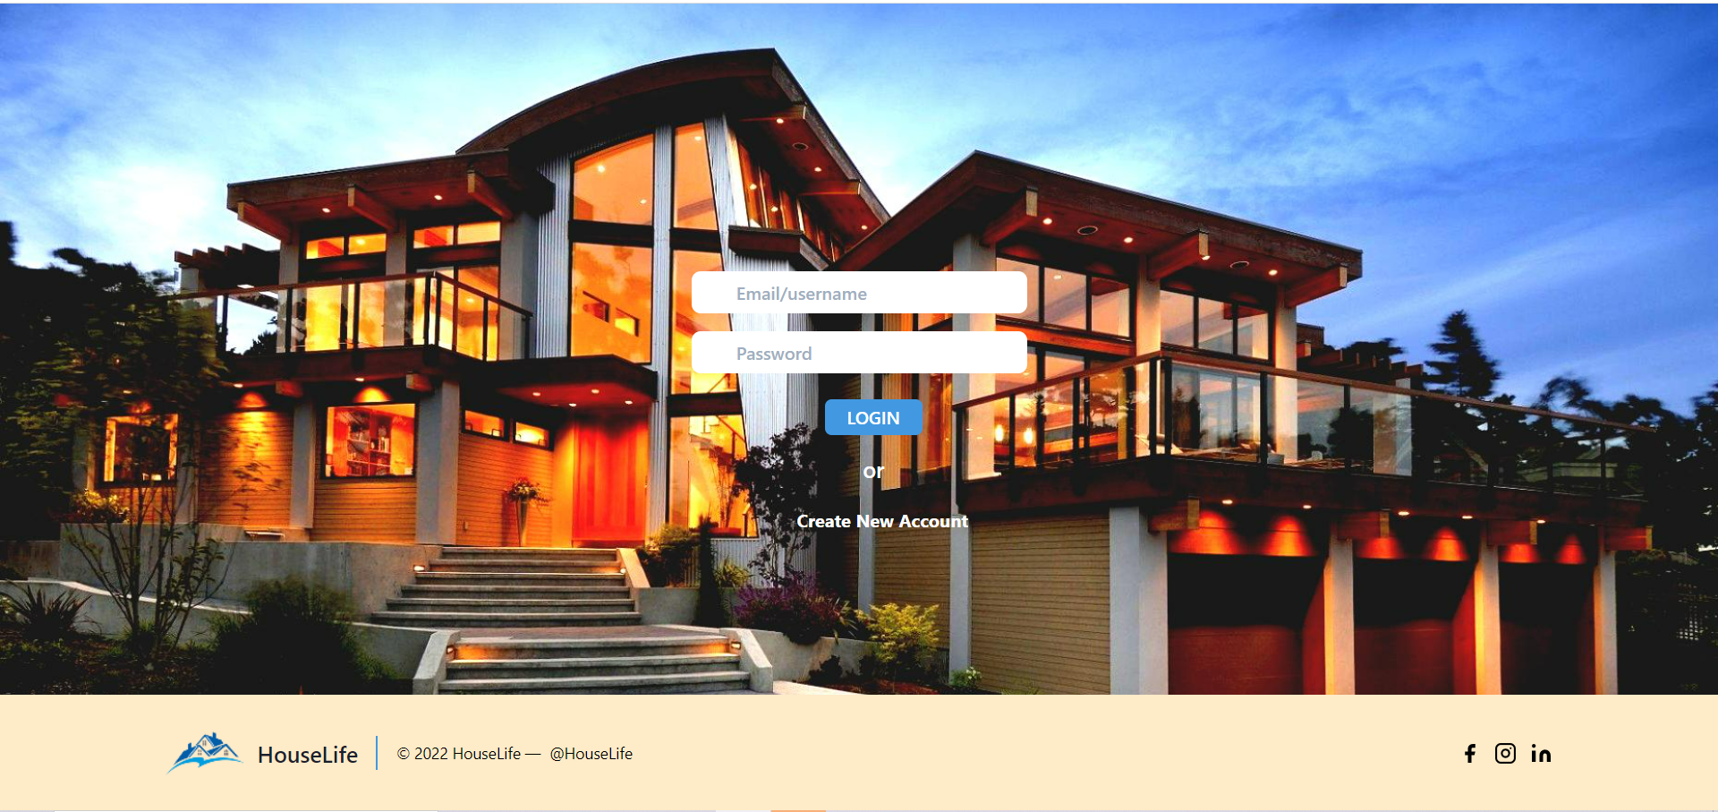
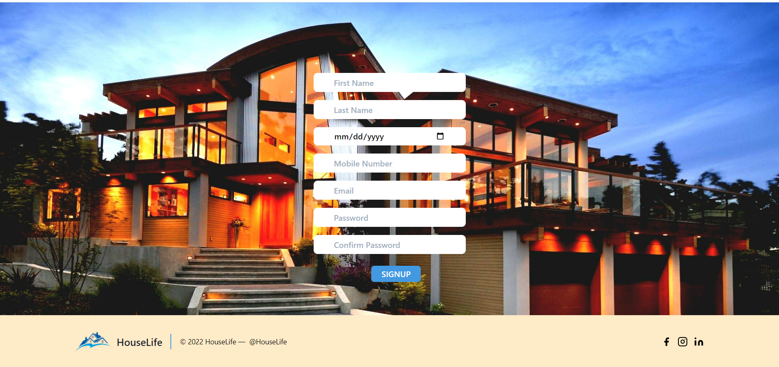
Login Page
Signup Page

Slide 12
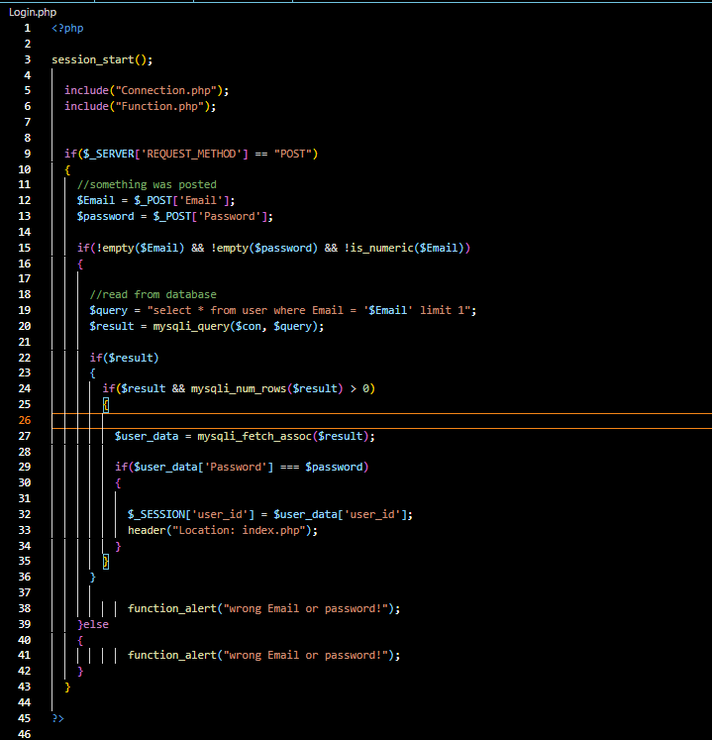
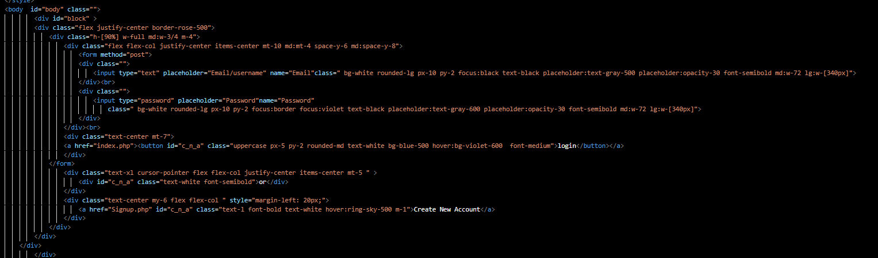
Login Page

Slide 13
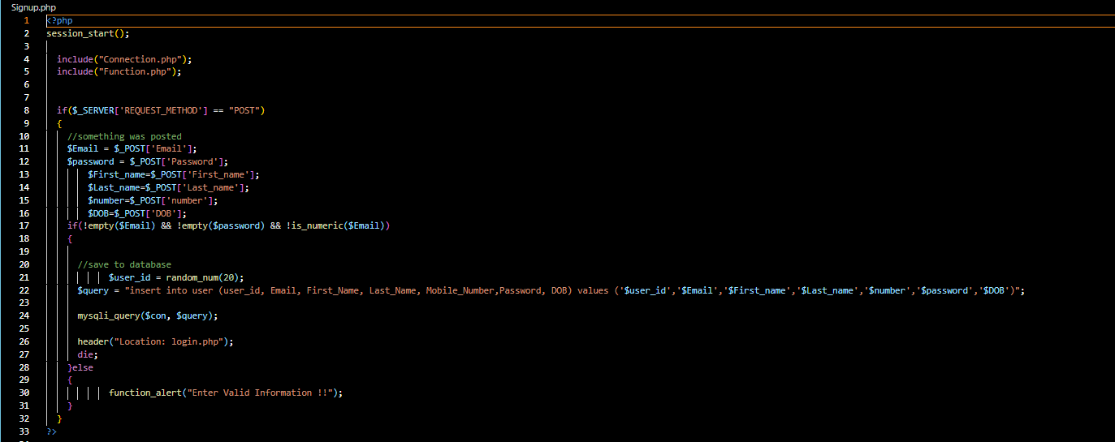
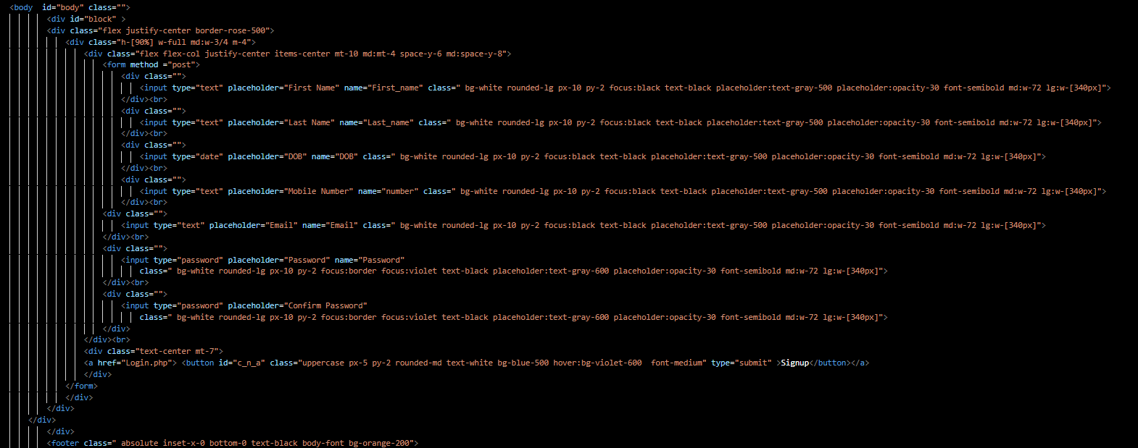
Sign up page

Slide 14
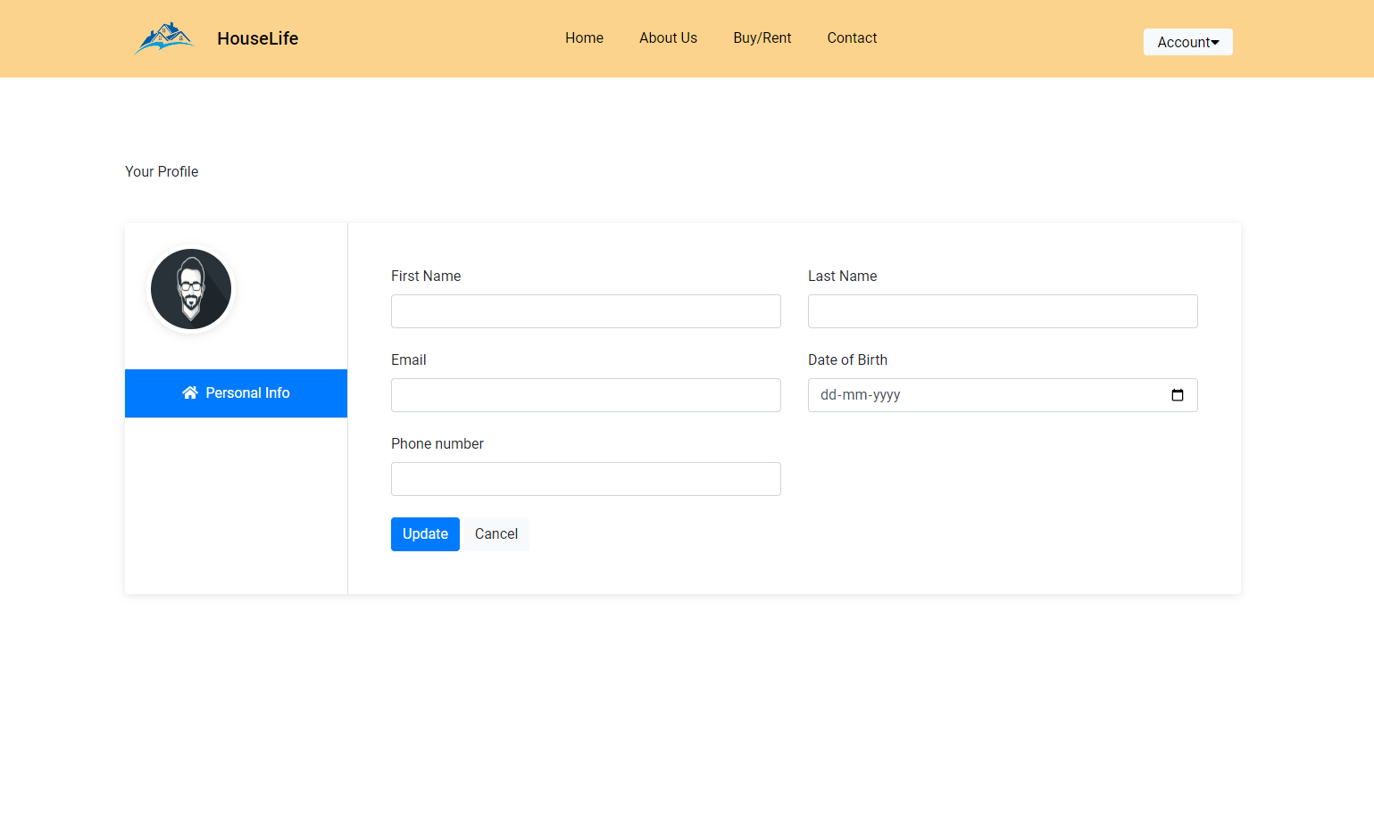
Account page

Slide 15
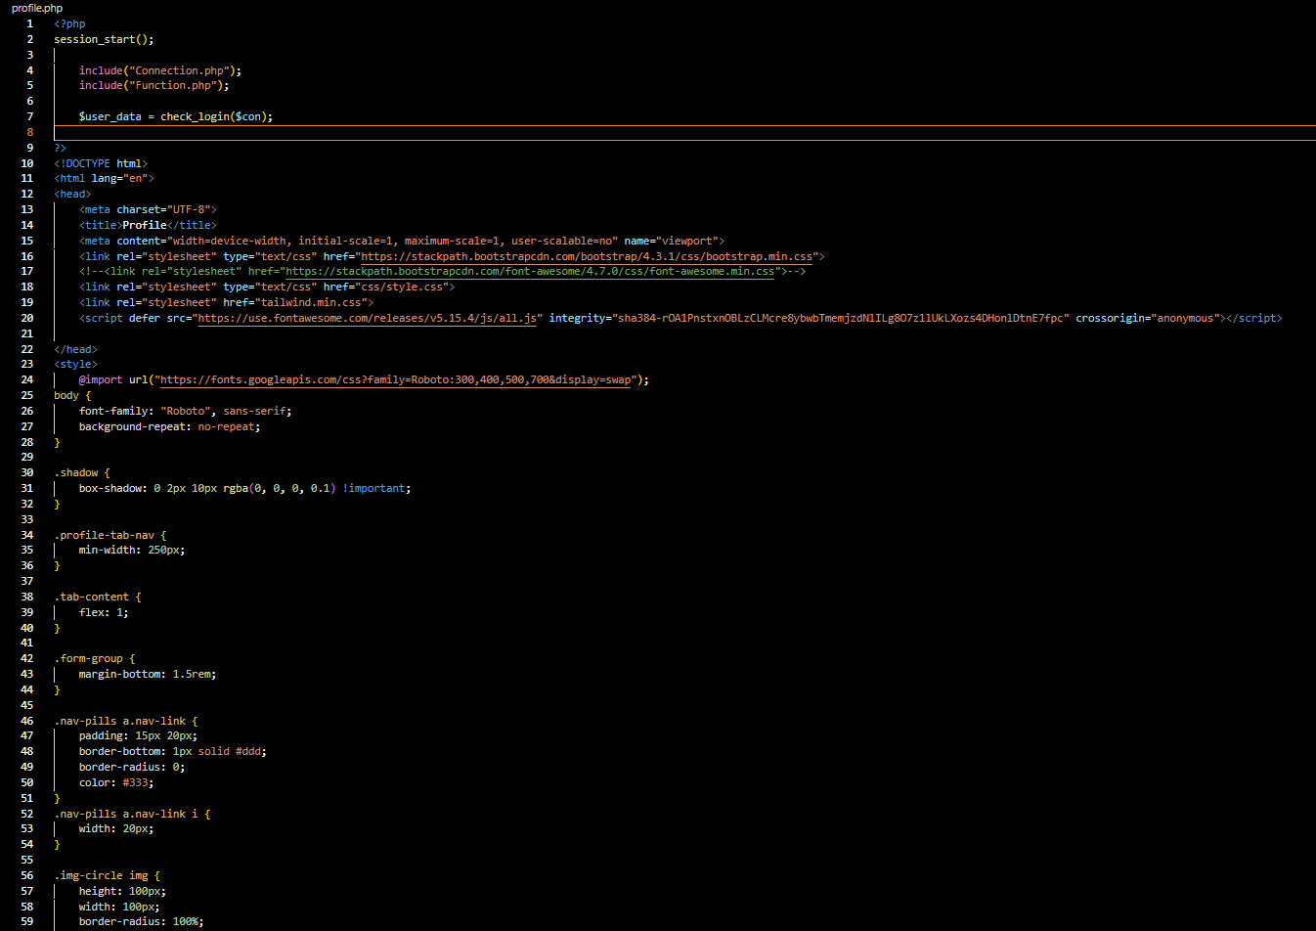
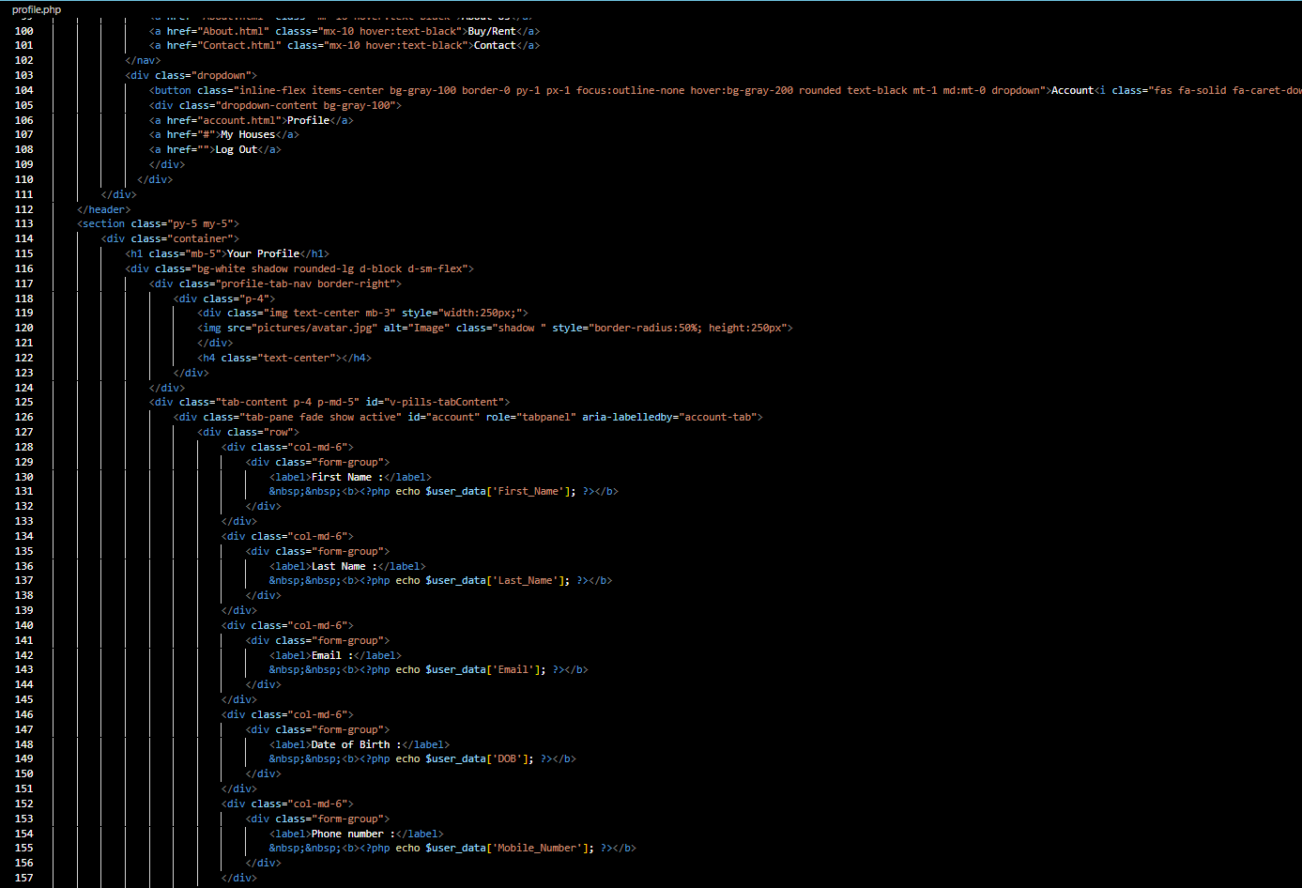
Profile/Account Page Code

Slide 16
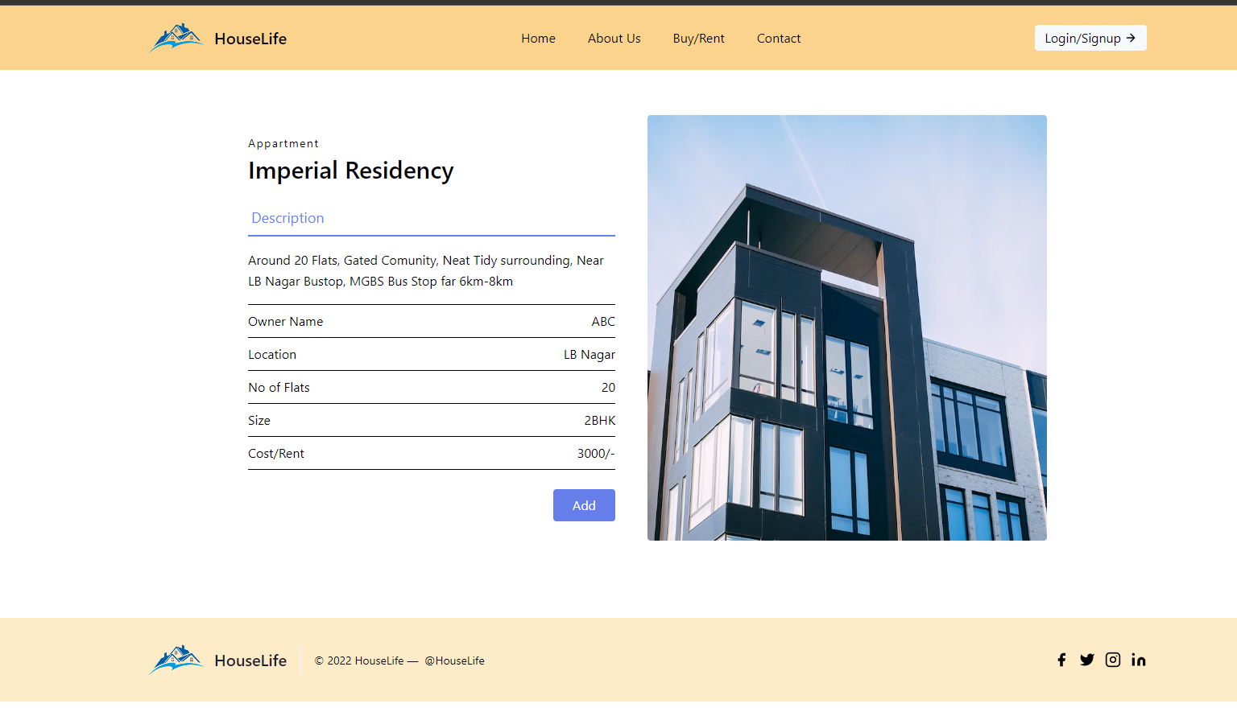
Description of Each House

Slide 17
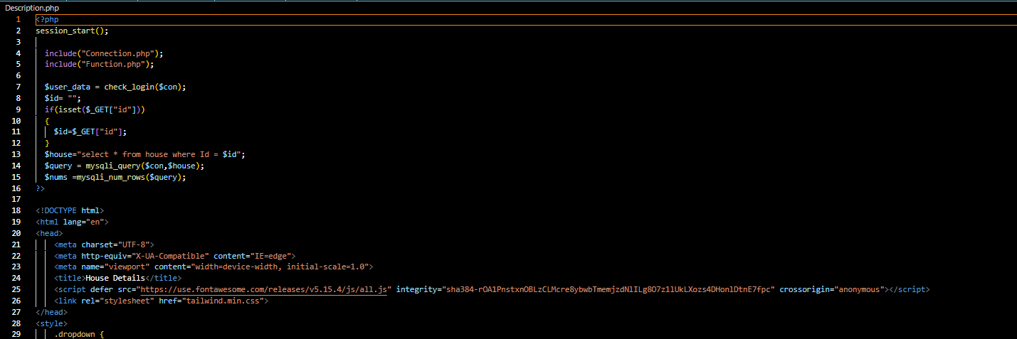
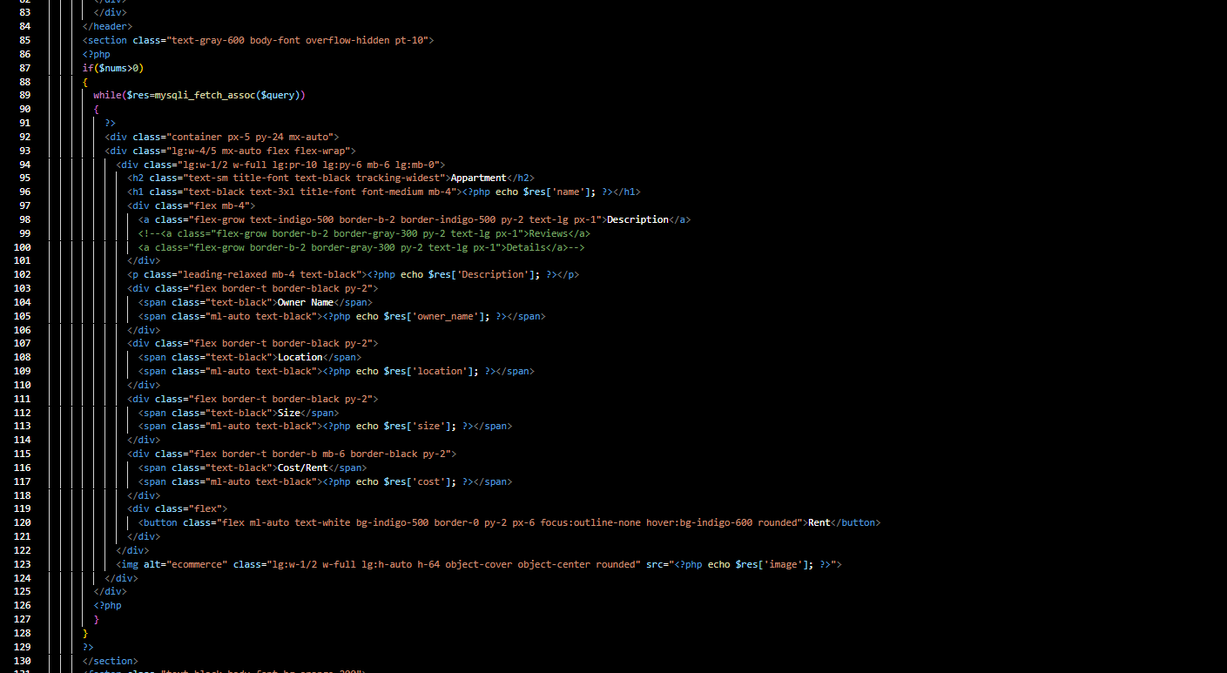
Description page

Slide 18
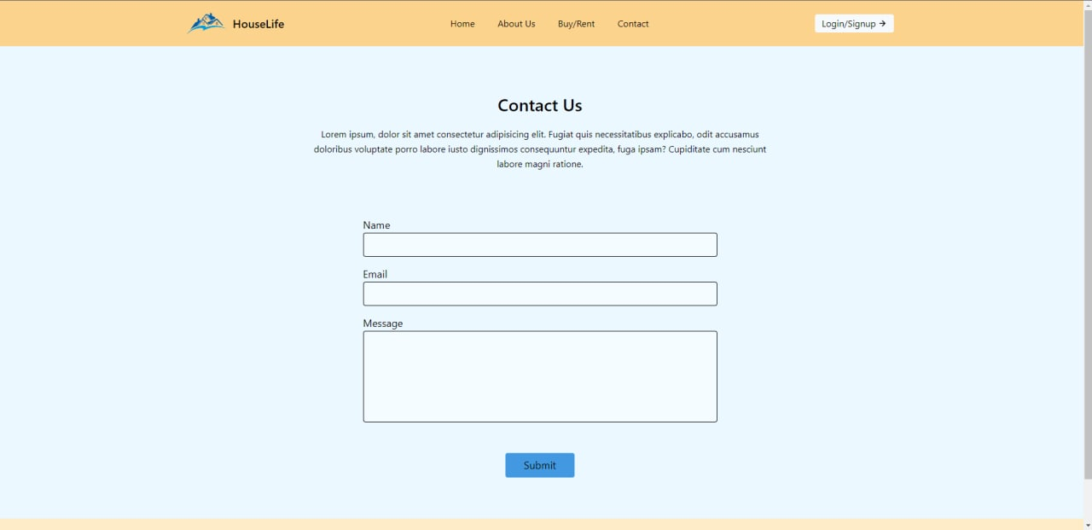
Contact Page

Slide 19
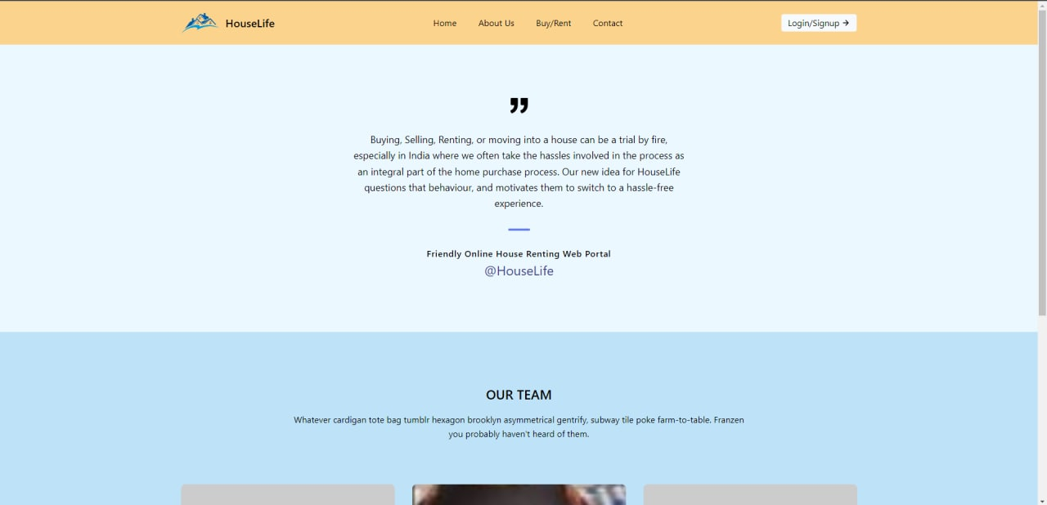
About Page

Slide 20
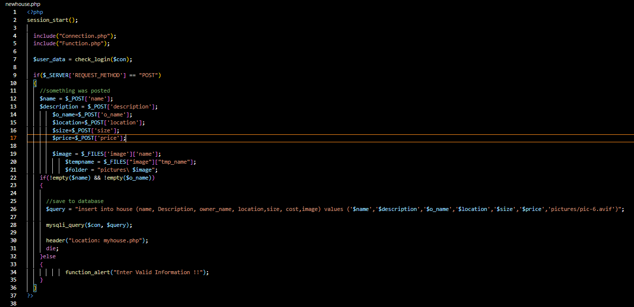
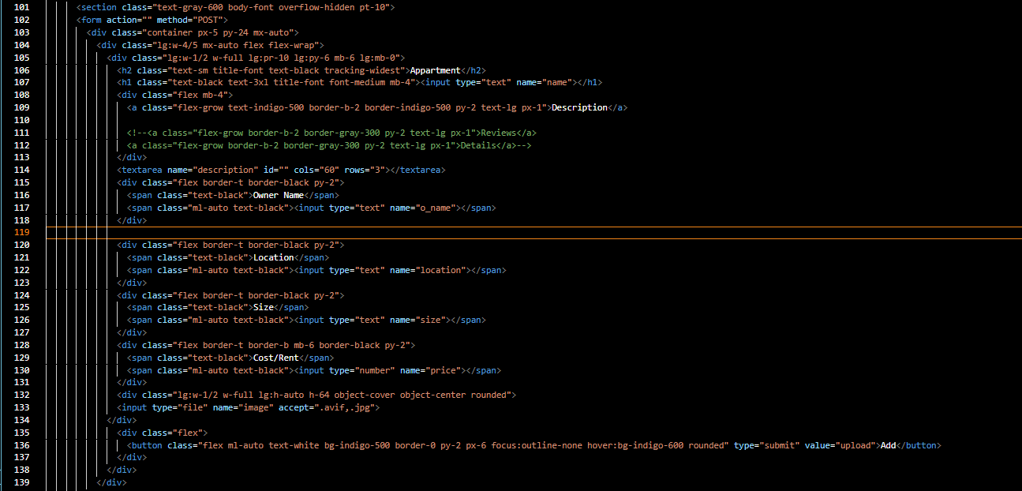
Adding new House

Slide 21
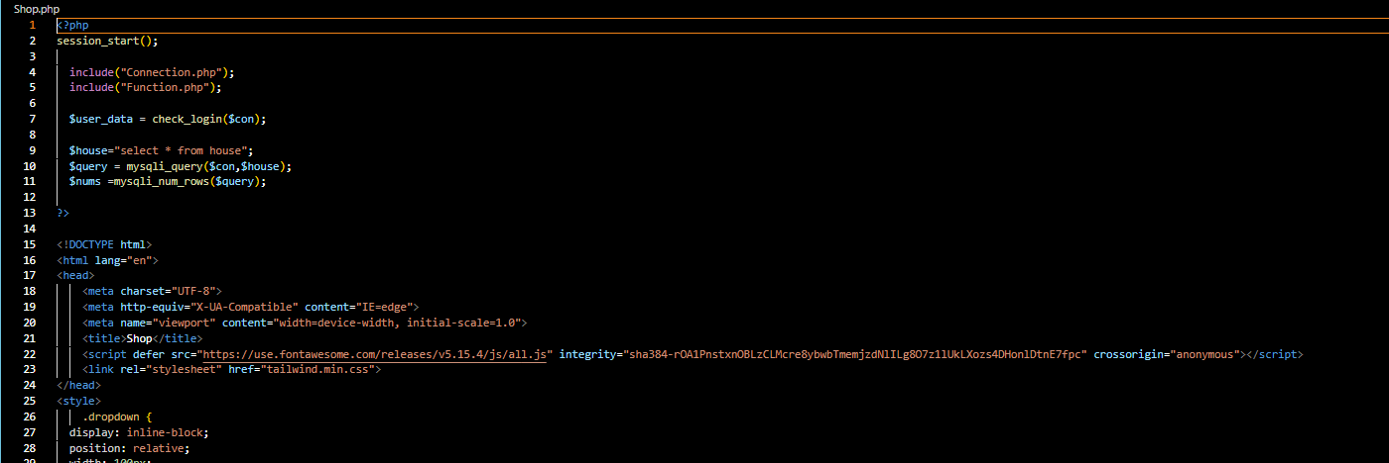
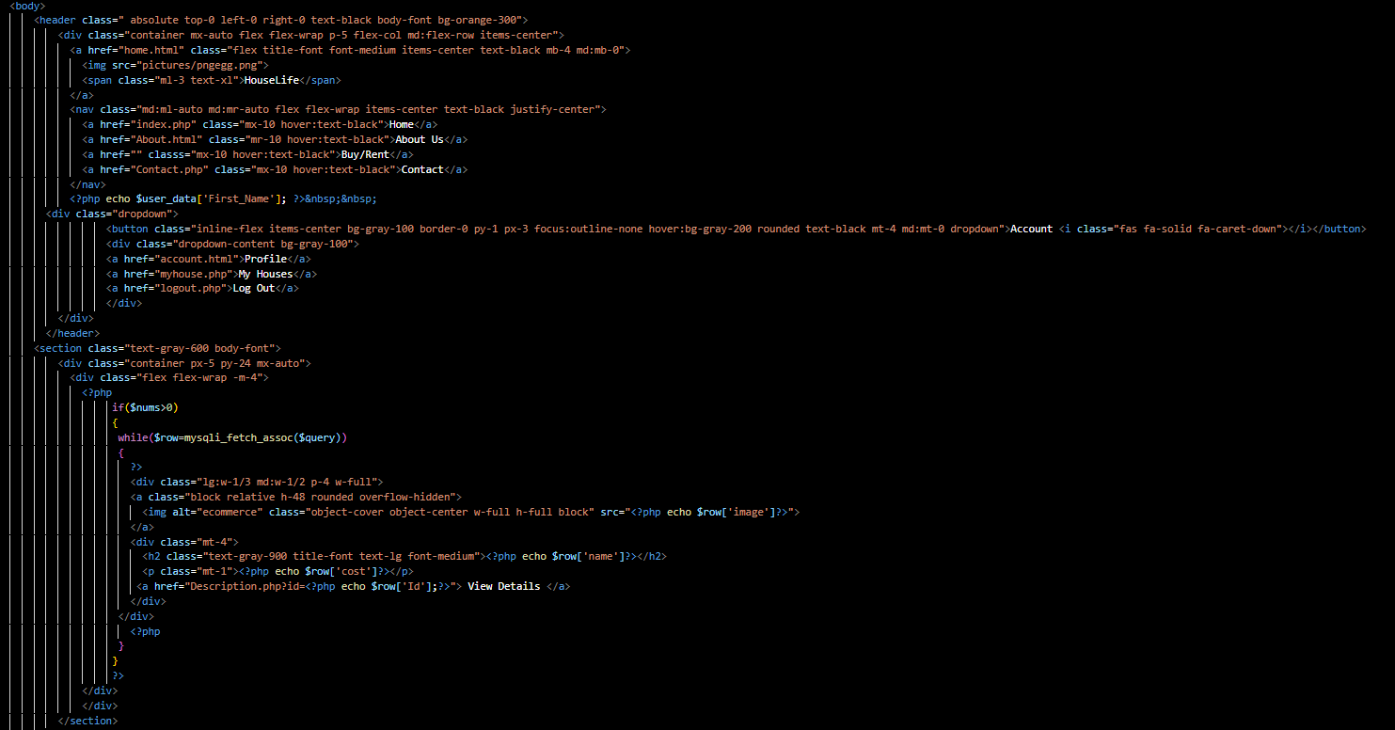
Buy/Rent page

Slide 22
Database Schema
user(user_id,first_name,last_name,email,mobile_number,password,dob)
house(house_name,description,owner_name, location,size , price, image)
bookings(b_id,house_id,house_name,first_name,last_name, email,address,b_date)

Slide 23
Tools Setup
JAVA
HTML
BOOTSTRAP
CSS
MYSQL
PHP-XAMMP

Slide 24
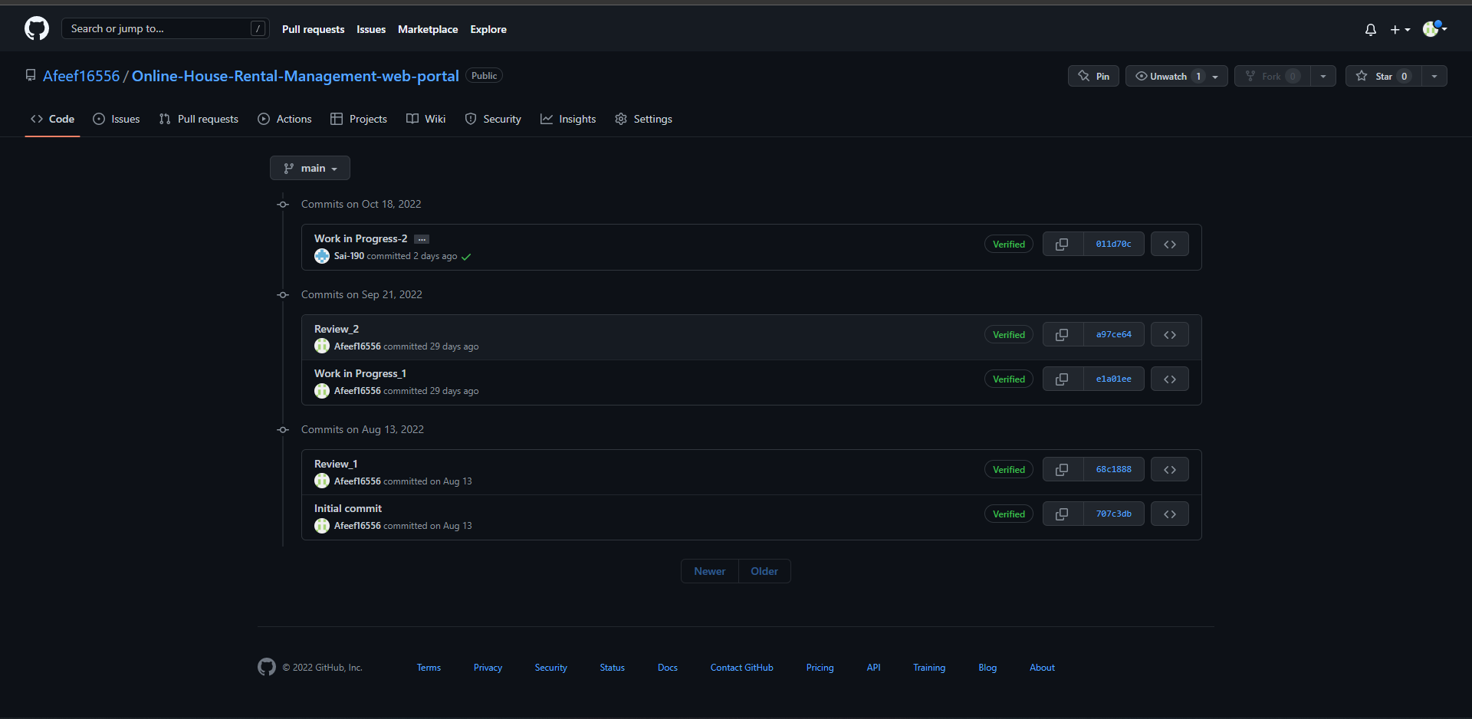
GitHub Setup
https://github.com/Afeef16556/Online-House-Rental-Management-web-portal.git

Slide 25
Conclusion
Online house rental business has emerged with a new possibilities compared to the past experience where every activity concerning house rental business was limited to a physical location only.
Even though the physical search for houses has not been totally eradicated; the nature of functions and how these functions are achieved has been reshaped by the power of internet.
Nowadays, renters can reserve houses online once the customer is a registered member of the website.

Slide 26
Thank You

